Slide 1
Intro to Neural Network & Deep Learning Session 20
Course : COMP6065001- Artificial Intelligence
Effective Period : September 2022

Slide 2
Learning Outcomes
At the end of this session, students will be able to:
LO 5: Apply various learning algorithms to solve the problems

Slide 3
Outline
Introduction
Artificial Neural Network
Backpropagation
Deep Learning
Understanding Deep Learning
Exercise

Slide 4
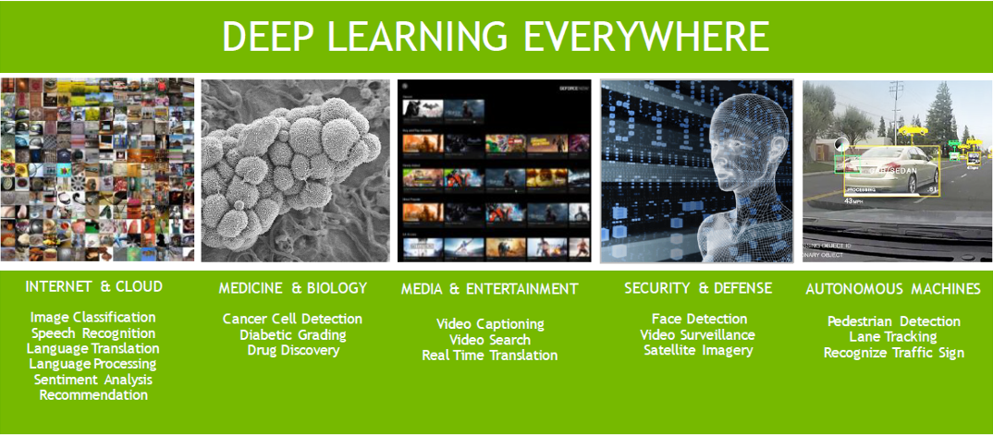

Slide 5
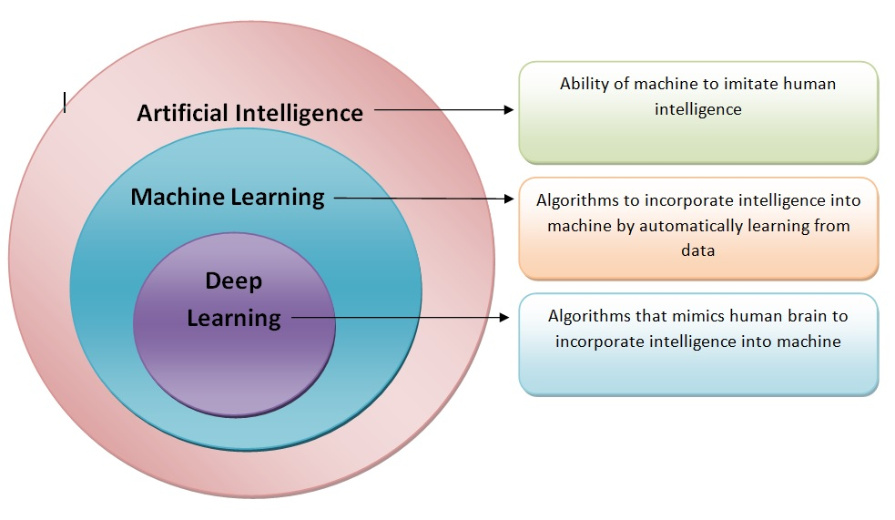
AI vs ML vs DL

Slide 6
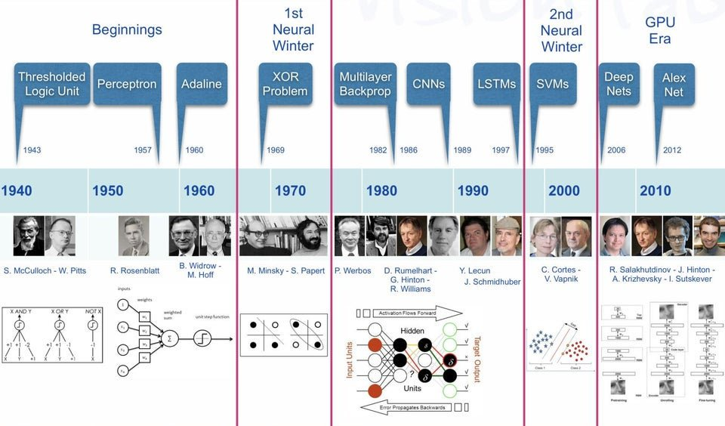
Neural Network Timeline

Slide 7
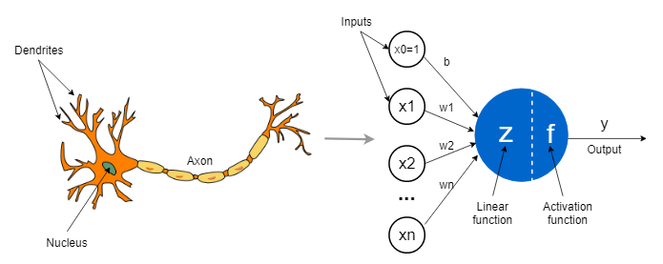
Basic Concept of ANN

Slide 8
Artificial Neural Network
An artificial network that imitates the neurons in our brain
There is hypothesis that mental activity consists of electrochemical activity in network of brain cells
Each node in ANN fires when a linear combination exceed some threshold (linear classifier)

Slide 9
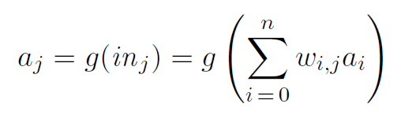
Artificial Neural Network
Neural networks are composed of nodes or units connected by directed links
A link from unit i and j serves to propagate activation a_{i}
Each link has numeric weight w_{i,j} associated with it
Then, we apply activation function g to derive the output (activation) a

Slide 10
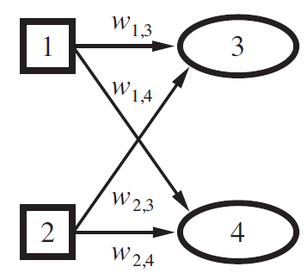
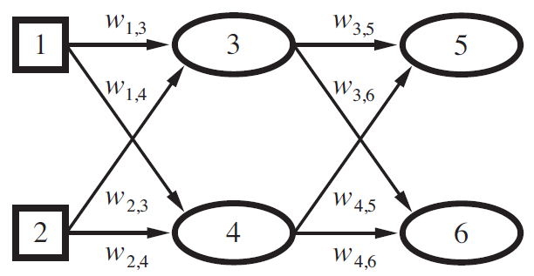
Artificial Neural Network
Feed-forward neural networks
Single-layer (Perceptron network)
Works in linear problem only
Multi-layer network
Works in non-linear problem too

Slide 11
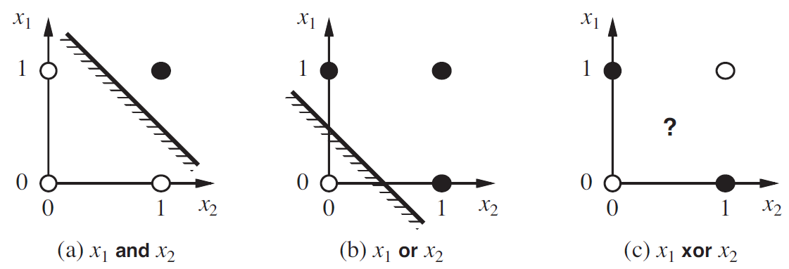
Artificial Neural Network
See the cases of and, or, xor for single-layer perceptron
How can we solve the xor?

Slide 12
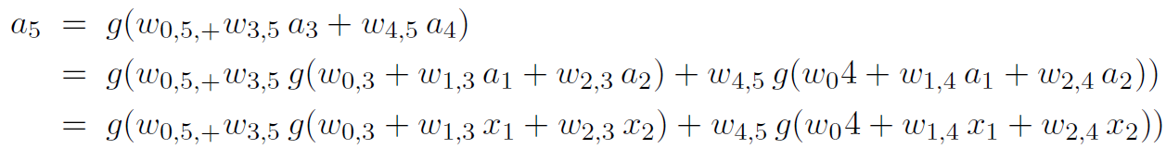
Artificial Neural Network
Multi-layer network
Contains hidden units (3,4)
Activation function is complex
How can we optimize?
Using back propagation for gradient descent!
We propagate the derivatives value

Slide 13
Backpropagation
The back-propagation process can be summarized as follows
Compute the derivative values for the output units, using the observed error
Starting with output layer, repeat the following for each layer until the earliest hidden layer is reached
Propagate the derivative values back to the previous layer
Update the weights between the two layer

Slide 14
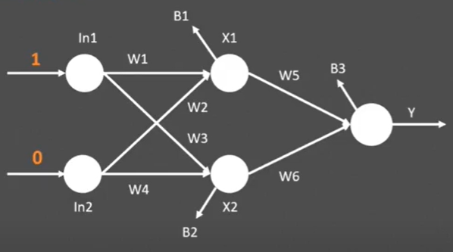
W1=0.15, W2=0.4, W3=0.6
W4=0.1, W5=0.21, W6=0.31
B1=1, B2=1, B3=1

Slide 15
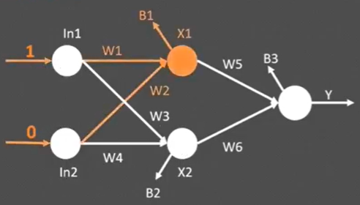
X1=(In1*W1)+(In2*W2)+B1
=(1*0.15)+(0*0.4)+1
=1.15

Slide 16
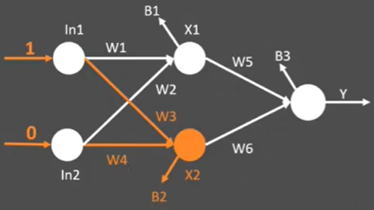
X2=(In1*W3)+(In2*W4)+B2
=(1*0.6)+(0*0.1)+1
=1.6

Slide 17
X1=1/(1+e^-1.15)
=1/(1+0.31664)
=0.75991
X2=1/(1+e^-1.6)
=1/(1+0.201397)
=0.832018

Slide 18
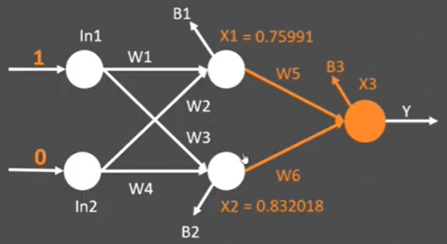
X3=(X1*W5)+(X2*W6)+B3
=(0.75991*0.21)+(0.832018*0.31)+1
=1.41742299

Slide 19
X3=1/(1+e^-1.41742299)
=1/(1+0.24233)
=0.80493

Slide 20
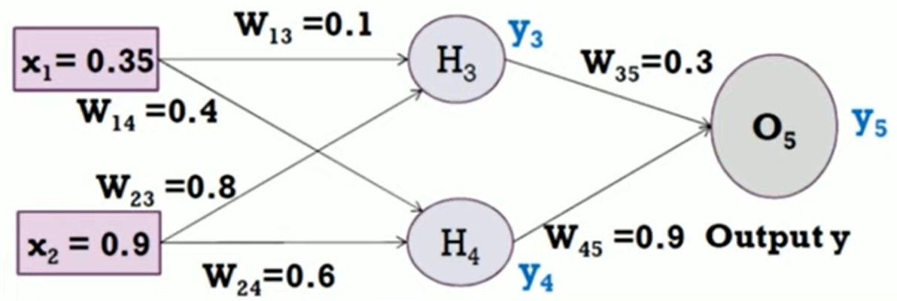
Example
Actual output of y is 0.5
Learning rate is 1

Slide 21
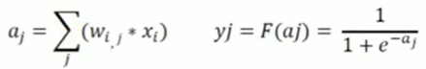
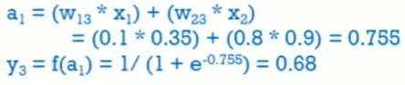
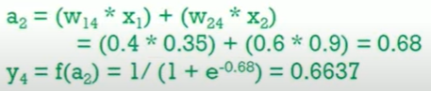
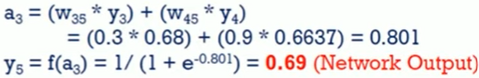

Forward Pass
Compute
y3, y4 and y5

Slide 22
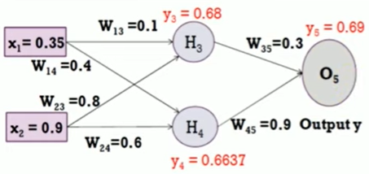
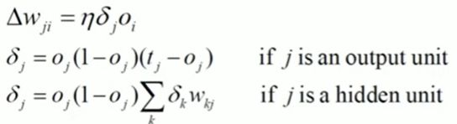
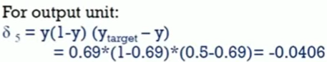
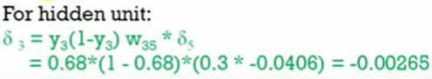
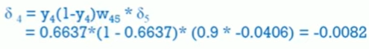
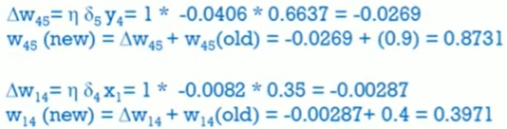
Backward Pass
Compute
δ3, δ4, and δ5

Slide 23
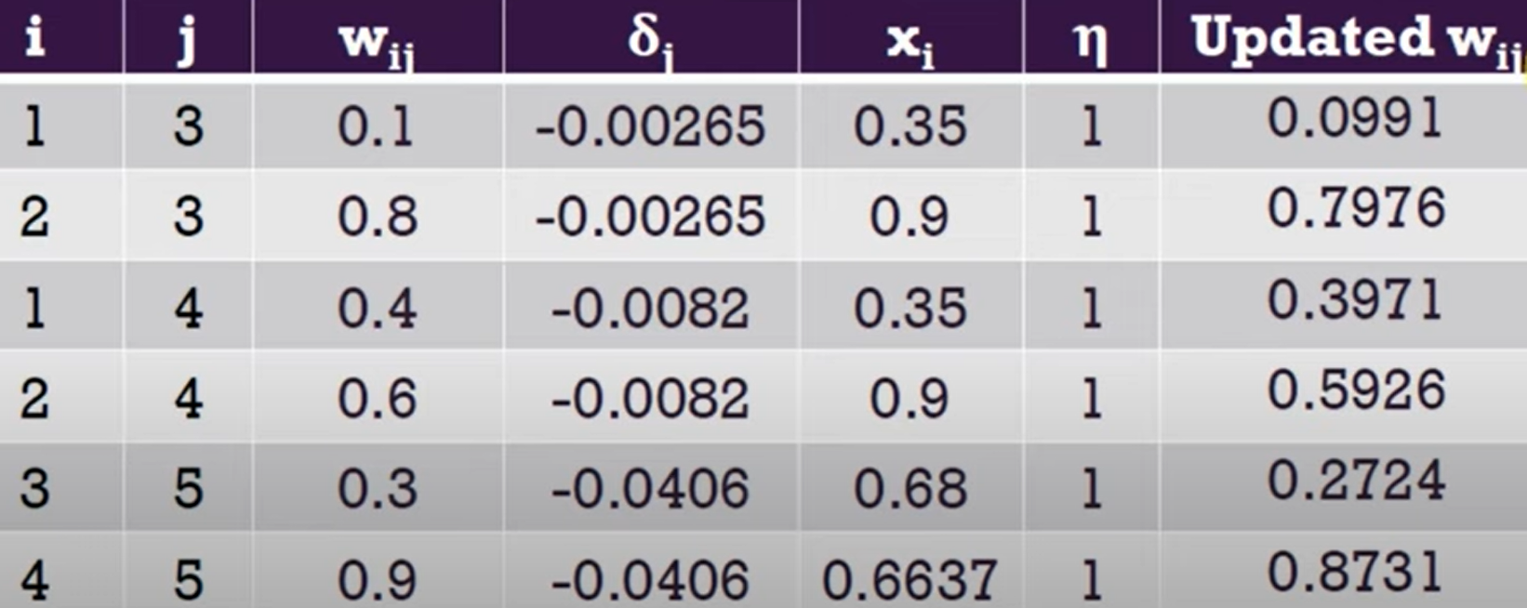
Update all other weight

Slide 24
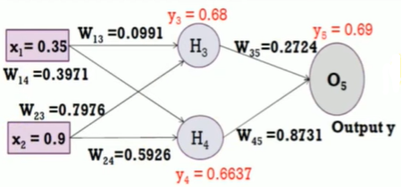
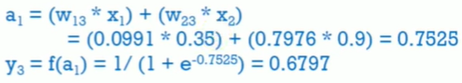
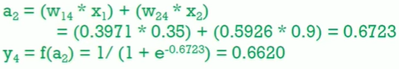
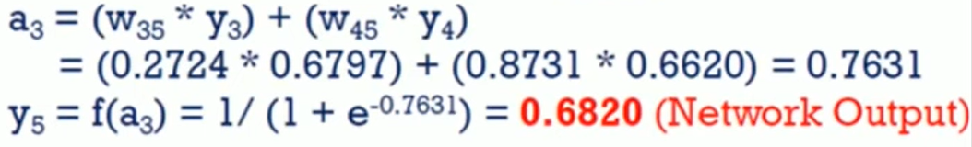

Forward Pass
Compute
y3, y4 and y5

Slide 25
NN Before 2010
Typically use no more than 5 hidden layers. Using more layers can degrade its performance
Use sigmoid as the activation function of all hidden layers
Its performance is usually inferior to Support Vector Machine (SVM), the most popular machine learning algorithm at the time

Slide 26
Why NN didn’t work before 2010? Answer: The Vanishing Gradient Problem
Because of the mathematics of backpropagation, the earlier layer receive smaller error signal
The earliest layer might learn almost nothing from the error signal as the number of layer grows

Slide 27
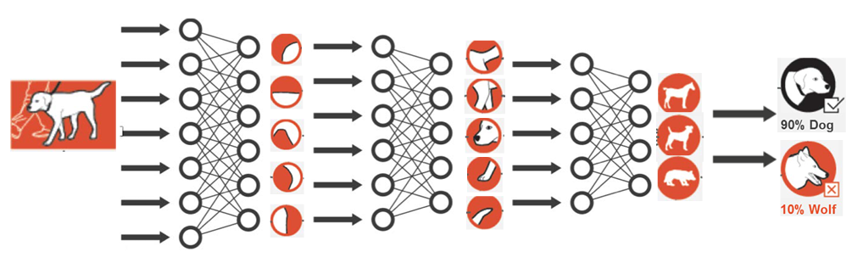
Deep Learning
Simply, neural networks with A LOT OF hidden layers, (or in other words, deep layers). Currently, it can hold hundreds of layers
Deep learning creates many layers of neurons, attempting to learn structured representation of big data, layer by layer.

Slide 28
Why do we need deep learning?
Process huge amount of data
Perform complex algorithms
To achieve the best performance with large amount of data
Feature extraction

Slide 29

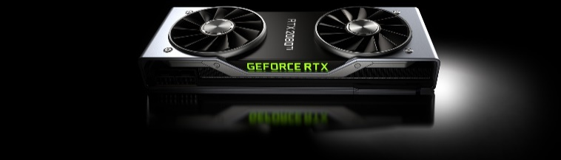
Why now?
Deep Learning was started to have an exceptional performance in 2010s thanks to these three factors:
Ability to train deeper NN architecture
Big Data
GPU acceleration

Slide 30

Deep Learning

Slide 31
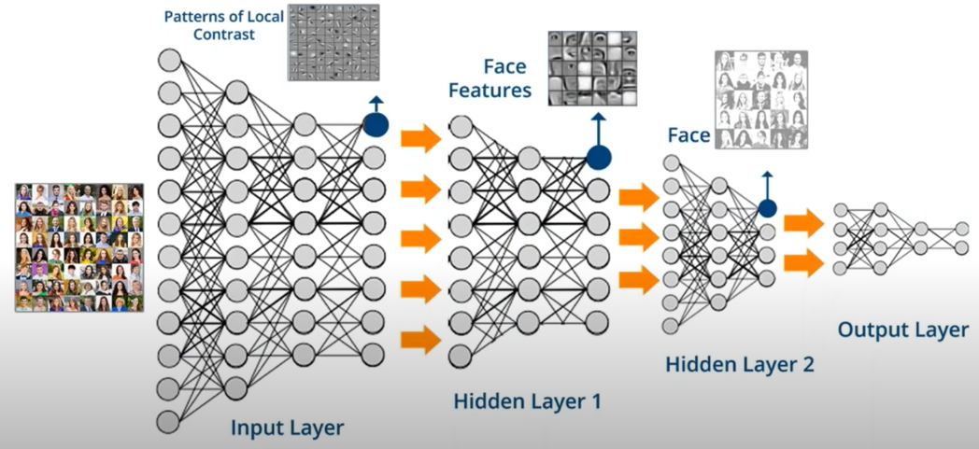
Understanding Deep Learning

Slide 32
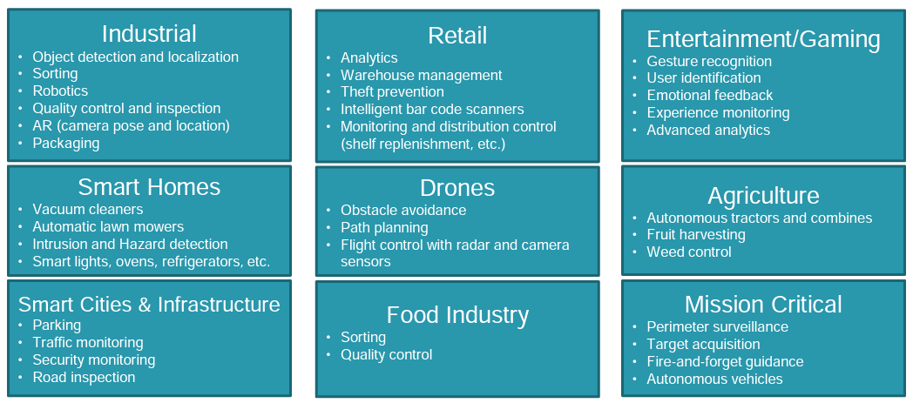
Deep learning: A few example uses

Slide 33
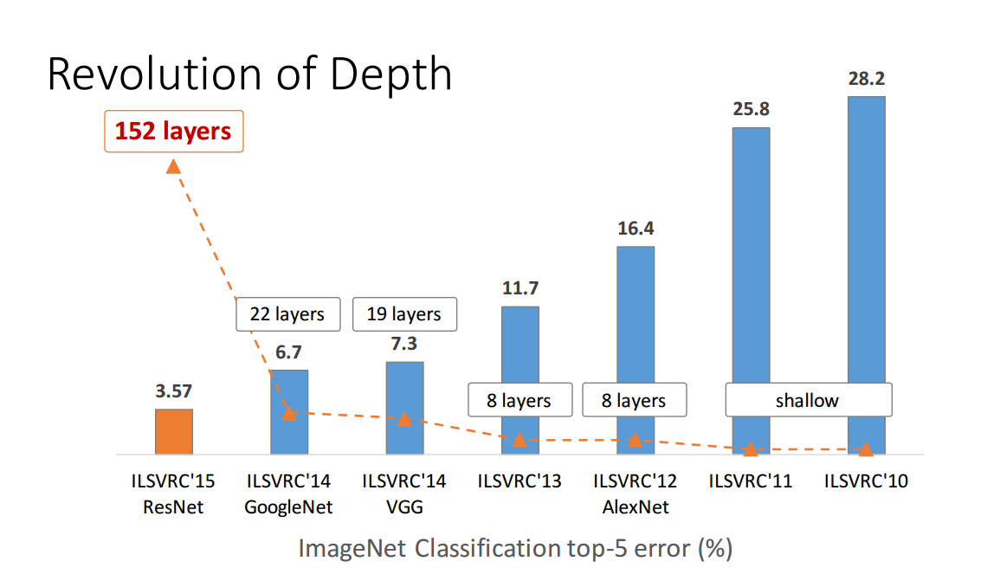
Deep neural networks
Many layers
Features are learned, not given
Low-level features combined into high-level features
Special types of layers
convolutional
drop-out
recurrent
...

Slide 34
References
Stuart Russell, Peter Norvig. 2020. Artificial Intelligence : A Modern Approach. Pearson Education. New Jersey. ISBN:9780132071482
Gareth James, Daniela Witten, Trevor Hastie, Robert Tibshirani. An introduction to Statistical Learning with Application R. 2nd Edition, 2021, Springer
http://cs231n.stanford.edu/slides/2018/cs231n_2018_lecture04.pdf

Slide 35
Exercise

Slide 36
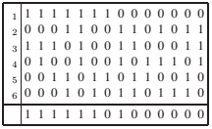
Exercise
Consider the following set of examples, each with six inputs and one target output:
Run perceptron learning rule on these data and show the final weights.

